Slide 1
BONES
By
Dr.PARDEEP KUMAR

Slide 2
Bones
Bone is a highly vascularised, mineralised & rigid type of connective tissue.

Slide 3
Composition of Bone
Bone cells
Osteoproginator cells, Ostoeoblast, Osteoclast, Osteocytes
Intercellular matrix
Organic
Collagen Fibers
Glycosaminoglycans
Glycoprotein
Proteo-glycans
Inorganic
Mostly Calcium phosphate
Calcium carbonate
Magnesium hydroxide, fluoride & sulphate (small amount

Slide 4
Functions of Bone
Bones perform several important functions:
Support
Protection
Movement
Mineral storage
Blood cell formation

Slide 5
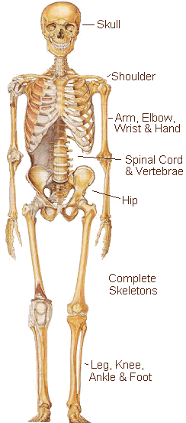
Function of bones
Support
Bones provide a hard framework that gives shape and support to the body .
Bones provide support for internal organs.

Slide 6
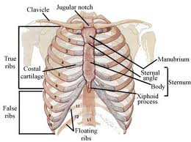
Function of Bones
Protection
Fused bones provide a brain case that protects this vital tissue
Spinal cord is surrounded by vertebrae
Rib cage protects vital organs

Slide 7
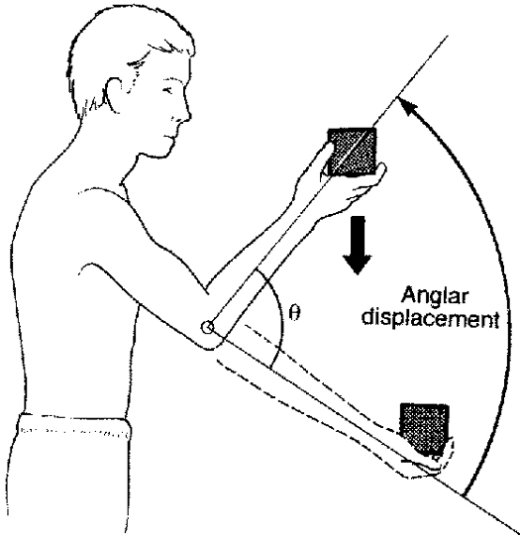
Function of Bones
Movement
Skeletal muscle attached to bones use the bones as levers to move the body
Arrangement of bones and joints determine the movements possible

Slide 8
Function of Bones
Mineral storage
Bone serves as a mineral reservoir
Phosphate and calcium ions can be released into the blood steam for distribution
Deposition and removal are ongoing

Slide 9
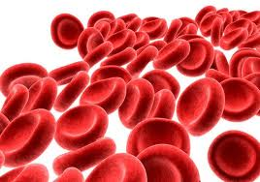
Function of Bones
Blood cell formation
Hematopoiesis occurs within the marrow cavities of the long bones.
The majority of hematopoiesis occurs in bones.

Slide 10
Classification of Bones
( According to size & shape)
Long bone – femur, tibia, fibula.
Short bone – Carpal & tarsal bones
Irregular bone – Vertebrae, Hip bones
Flat Bone – Sternum, , Parietal, Frontal
Sesamoid bone – Patella, pisiform
Pneumatic Bone – Maxilla
(According to structure)
Compact bone:- shaft of long bone
Spongy bone:- ends of long bone covered by thin layer of compact bone

Slide 11
Classification According to size & shape
Long bones
Typically longer than wide
Have a shaft with heads at both ends
Contain mostly compact bone
Examples: Femur, humerus
Short bones
Generally cube-shape
Contain mostly spongy bone
Examples: Carpals, tarsals

Slide 12
Classification According to size & shape
Irregular bones
Irregular shape
Do not fit into other bone classification categories
Example: Vertebrae and hip
Flat bones
Thin and flattened
Usually curved
Thin layers of compact bone around a layer of spongy bone
Examples: Skull, ribs, sternum

Slide 13
Classification According to size & shape
Pneumatic Bone
Some bones of base of skull contain air-filled cavities called air sinuses or air cells.
These bones are called pneumatic bones.
These cavities make the skull lighter and gives resonance to the voice.
Examples:
Maxilla
Ethmoid
Mastoid.
Sesamoid Bones
These are bony nodules located in the region where the tendon crosses a joint.
Functions:
These bones function as a fulcrum.
They serve to protect the tendons by limiting trauma from friction or pressure.
Examples:
Patella or knee cap

Slide 14
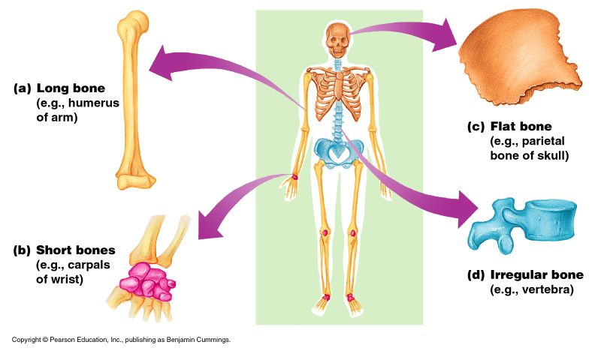
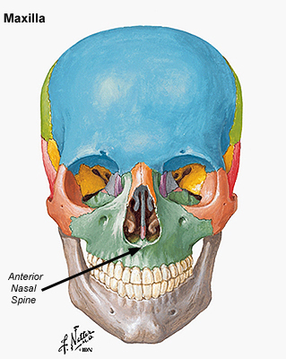
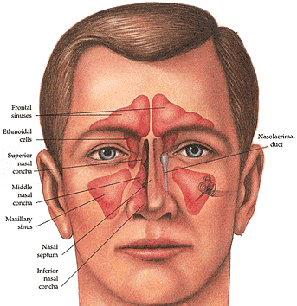

Slide 15
According to structure
Compact Bone
Spongy bone
Outer layer of bone.
It is very hard and dense.
It contains cylinders of calcified bone called osteons.
Osteon provides great strength needed to resist the stress to which long bones are subjected.
Located in the ends of long bones.
Many spaces that are filled with red bone marrow which produces bone cells.
It provides great strength with least weight.

Slide 16
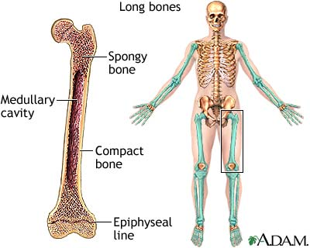
Microscopically the structure of spongy & compact bone is the same
The only difference is that the space in the spongy bone is large while in the compact type the bone tissue is dense & contains narrow channels

Slide 17
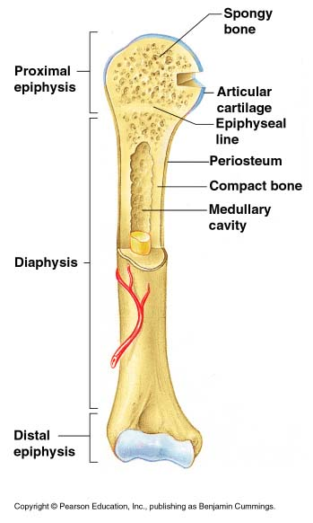
Gross Anatomy of a Long Bone
Diaphysis
Shaft
Composed of compact bone
Epiphysis
Ends of the bone
Composed mostly of spongy bone
Figure 5.2a

Slide 18
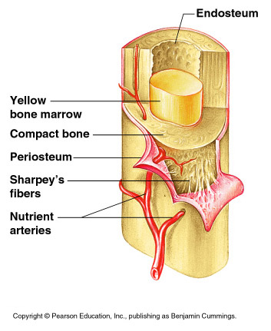
Structures of a Long Bone
Periosteum
Outside covering of the diaphysis
Fibrous connective tissue membrane
Endosteum
It is highly vascular membrane which lines the medullary cavity in the inner surface of compact bone
Sharpey’s fibers
Secure periosteum to underlying bone
Arteries
Supply bone cells with nutrients

Slide 19
Structures of a Long Bone
Articular cartilage
Covers the external surface of the epiphyses
Made of hyaline cartilage
Decreases friction at joint surfaces
Figure 5.2a

Slide 20
Structures of a Long Bone
Medullary cavity
Cavity of the shaft
Contains yellow marrow (mostly fat) in adults
Contains red marrow (for blood cell formation) in infants
Figure 5.2a

Slide 21
Microscopic Anatomy of Bone
Osteon (Haversian System)
A unit of bone
Central (Haversian) canal
Opening in the center of an osteon
Carries blood vessels and nerves
Perforating (Volkman’s) canal
Canal perpendicular to the central canal
Carries blood vessels and nerves

Slide 22
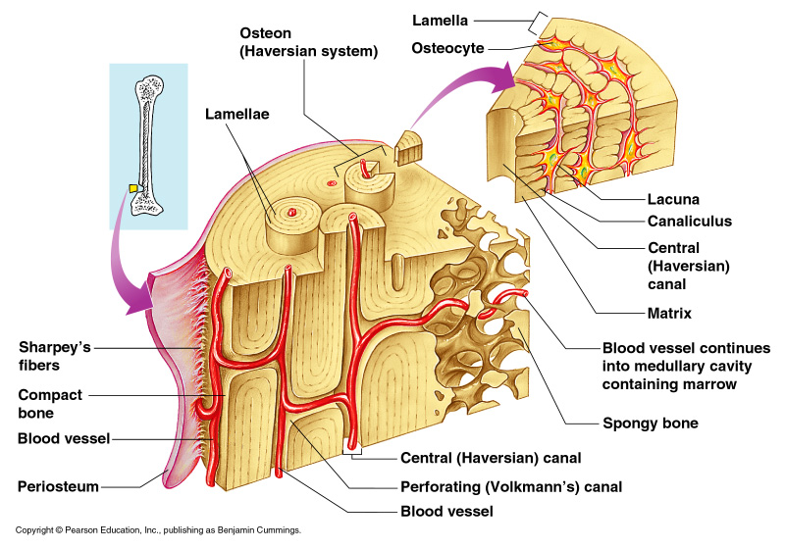
Microscopic Anatomy of Bone
Figure 5.3

Slide 23
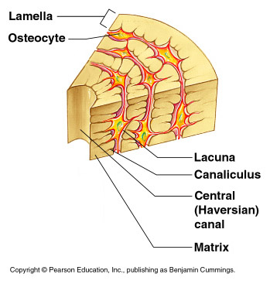
Microscopic Anatomy of Bone
Lacunae
Cavities containing bone cells (osteocytes)
Arranged in concentric rings
Lamellae
Rings around the central canal
Sites of lacunae
Figure 5.3

Slide 24
Microscopic Anatomy of Bone
Canaliculi
Tiny canals
Radiate from the central canal to lacunae
Form a transport system
Figure 5.3

Slide 25
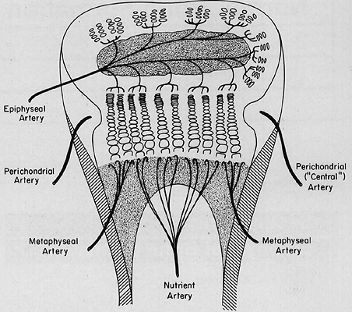
Blood supply of bones
Bone has a rich supply of blood. The distribution varies according to the type of bone
Long Bone
Long bone is supplied by 4 sets of blood vessels
Nutrient artery
Juxta-Epiphyseal or Metaphyseal vessels
Epiphyseal vessels
Periosteal Vessels

Slide 26
Nutrient artery
Enters the shaft through the nutrient foramen obliquely & reaches the medullary cavity where it is divided into ascending & descending branches
Area of supply
Medullary cavity, inner 2/3^{rd of} compact bone of Diaphysis & metaphysis

Slide 27
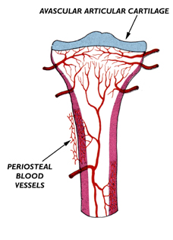
Juxta-Epiphyseal or Metaphyseal vessels
These are derived from the anastomosis around the joint
Area of Supply
They supply the Epiphyseal end
Epiphyseal vessels
Derived from the anastomosis around the joint
Area of supply
The spongy part & red marrow of bones
Periosteal Vessels
Derived from the vessels of periosteum
Area of supply
Outer 1/3rd of compact bone

Slide 28
Blood Supply of short Bones
Recieve numerus fine blood vessels from the periosteum
These vessels enter through non-articular surface
Supply both compact and spongy bone, & bone marrow.

Slide 29
Blood Supply of Flat Bones
Periosteal plexus.
Blood Supply of Irregular Bones
Large nutrient artery
Periosteal plexus.

Slide 30
Nerves Of Bone
Nerves are most numerus at articular areas of all types of bone.
Nerves are distributed throughout the periosteum.
Periosteum is the most sensitive part.
Compact bone is less sensitive to spongy bone.

Slide 31
Ossification
The process of gradual bone formation by depositing minerals from membranous or cartilaginous model is called ossification
Types of Ossification
Intra membranous Ossification:
Involves the replacement of sheet like connective tissue membranes with bony tissue
In this process the future bones 1st formed as connective tissue membranes. Osteoblasts migrate to the membranes and deposit bony matrix around them.
Examples of bones formed in this manner are certain flat bones of the skull and some irregular bones.

Slide 32
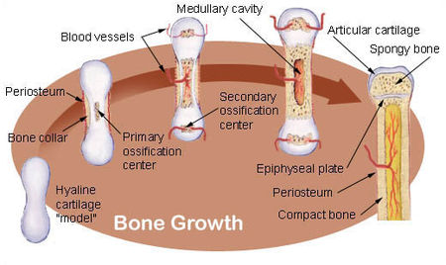
Intra cartilaginous:
Involves the replacement of hyaline cartilage with bony tissue
In this process the future bones 1st formed as cartilage models.
They become infiltrated with blood vessels and Osteoblast.
The Osteoblast forms a collar of compact bone around the Diaphysis.
At the same time Osteoclast breakdown the central bone tissue to form the medullary cavity
Later usually after birth secondary centre of ossification develop in the epiphysis.
Ossification in the epiphysis is similar to that in the Diaphysis except that the spongy bone is retained instead of being broken down into medullary cavity.

Slide 33
Factors affecting growth of bone
Adequate blood supply
Availability of adequate amount of minerals esp. Ca & PO4
Vitamin D – Essential for absorption, utilization & maintenance of Ca & PO4 at normal levels
Vitamin C – Essential for the normal matrix formation
Mechanical factors – Tensile force helps in bone formation .
Hormones
Growth Hormone & thyroid hormone [Thyroxine & triiodothyronine] – are especially important during infancy & childhood for development of skeleton.
Testosterone & Oestrogen – Influences the physical changes that occur at Puberty.
Calcitonin & Parathormone – are involved in Homeostasis of blood & bone calcium levels required for bone development.

Slide 34
Differences between bone & cartilage
 | Bone | Cartilage
Consistency | Hard | Soft
Calcification | Matrix is calcified | Matrix is not calcified
Blood Supply | Vascular | Avscular
Nerve supply | Present | Absent
Haversian System | Present | Absent
Covering | Periosteum | Perichondrium
Other | Never turns back into cartilage | Turns into bony calcification

Slide 35
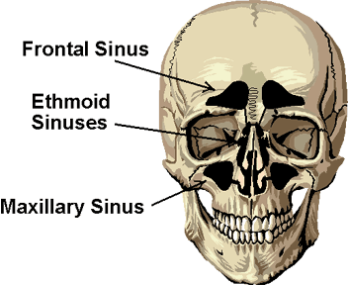
Sinuses
Sinuses are small air filled cavities in the bone & are found in Frontal, Sphenoid, Ethmoid & maxillary.

Slide 36
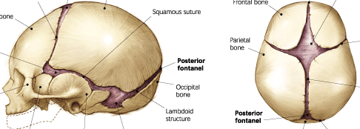
Fontanel–
An area of unossified area lying between the cranial bones of the a foetus
E.g. Anterior Fontanel, Posterior Fontanel

Slide 37
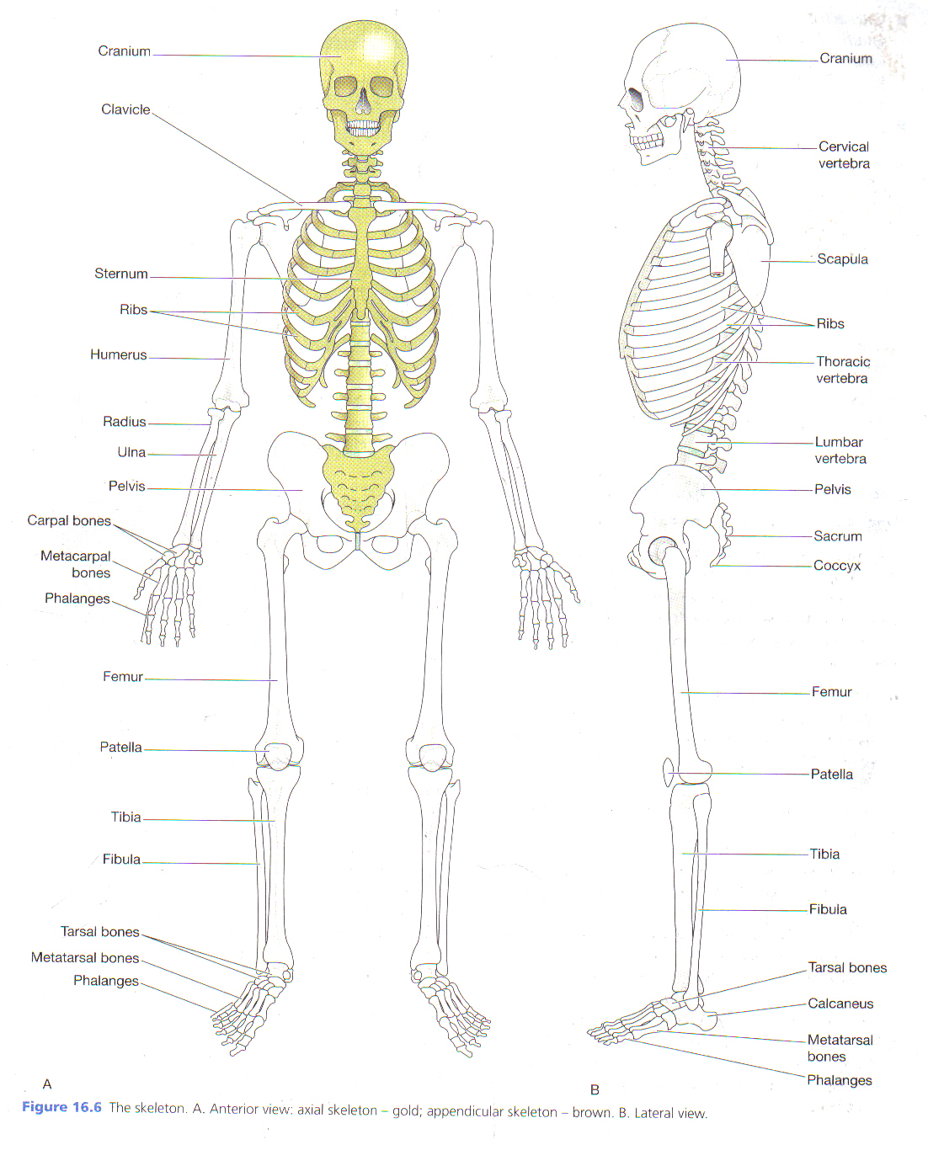
Skeleton
The skeleton is described into 2 parts
Axial skeleton
Appendicular skeleton

Slide 38
Axial skeleton
It consists of
Skull
Vertebral Column
Sternum
Ribs

Slide 39
Appendicular skeleton
It consists of
Bones of Upper Limb & Shoulder
Clavicle
Scapula
Humerus
Ulna
Radius
Carpals [Scaphoid, Lunate, Triquetral, Pisiform, ]
[Trapezium, Trapezoid, Capitate, Hamate,]
Metacarpals
Phalanges

Slide 40
Bones of Lower Limb & Pelvis
Hip Bone
Femur
Tibia
Fibula
Patella
Tarsals
Metatarsals
Phalanges

Slide 41
Vertebral Column
It consists of
7 Cervical [Atlas, Axilla]
12 Thoracic
5 Lumbar
1 Sacrum [5 fused bone]
1 Coccyx [4 fused bone]
The bodies of the bones are separated from each other by intervertebral discs consisting of Cartilage.

Slide 42
Thoracic Cage
Is formed by
12 thoracic Vertebrae
12 pairs if Ribs
1 Sternum

