Slide 1
Arthrology & Joints of Bones of Trunk
By
Dr.Pardeep Kumar

Slide 2
Arthrology
It is a science concerned with the study of joints.
In order to serve the purposes of protection and movement, the bones must be joined together one another by connective tissue at different parts of their surfaces, and such connections are termed Joints or Articulations.

Slide 3
Classification of joints
Joints
Synarthrosis Diarthrosis
Fibrous Cartilagenous Synovial

Slide 4
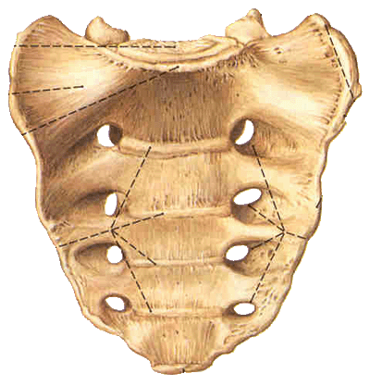
Synarthrosis
A synarthrosis is a type of joint which permits very little or no movement under normal conditions.
The synarthrosis occurs between the bones that is almost direct contact, fastened together by intervening connective tissue or hyaline cartilage, and in which there is no appreciable motion. It includes the
Fibrous joints
Cartilaginous joints
Synostosis.

Slide 5
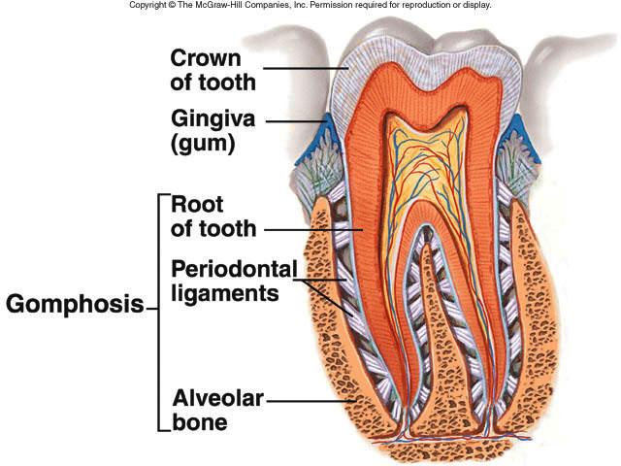
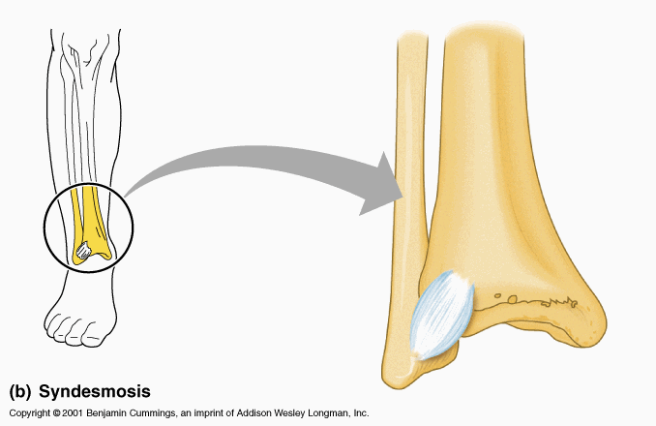
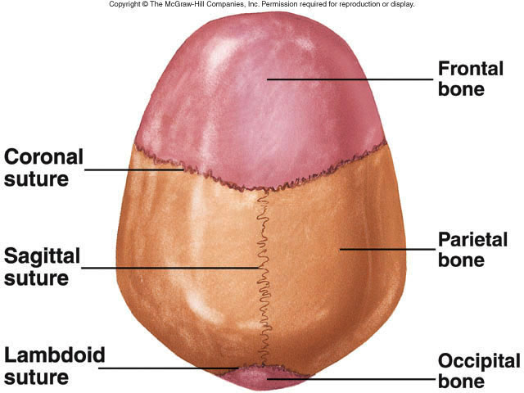
Fibrous Joints (Fixed joint)
The joints that are held together by dense fibrous tissue
No movement occurs in these joints except syndesmoses which allows little movement
Types of Fibrous Tissue:
Suture
Syndesmoses
Gomphosis

Slide 6
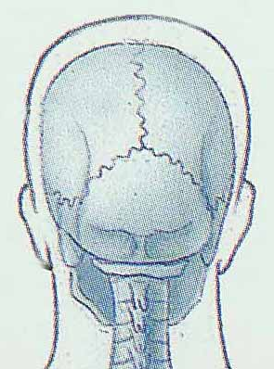
Sutures
1.Thin layer of dense fibrous connective tissue unites bones of
the skull
2.Immovable (synarthroses)
3.If fuse completely in adults is synostosis

Slide 7
Syndesmoses
Type of fibrous joint where the bones are united by interoseous ligament & the bones concerned are some distance apart
Such ligaments persists throughout life and a slight movement is possible
e.g. Radioulnar joint, Tibiofibular joint.

Slide 8
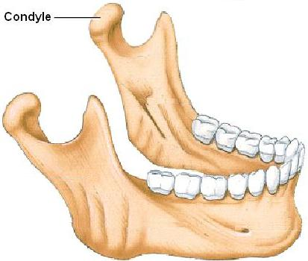
Gomphosis
It is a specialized articulation restricted to the fixation of teeth in the maxilla & mandible

Slide 9
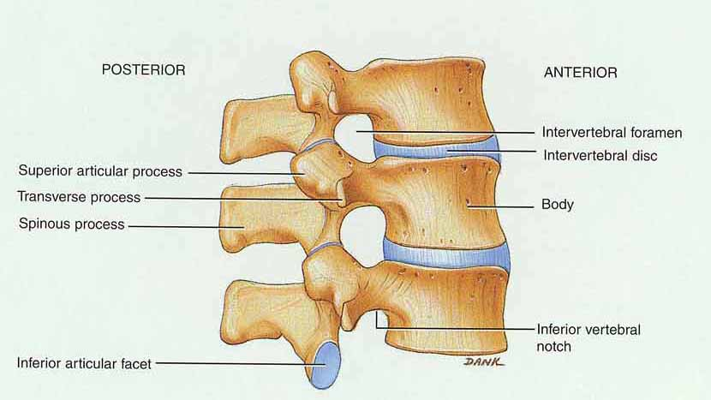
Cartilaginous Joints (slightly movable joint)
The joints that are held together by cartilage
Here a little amount of movement is possible.
2 types
synchondrosis
symphysis

Slide 10
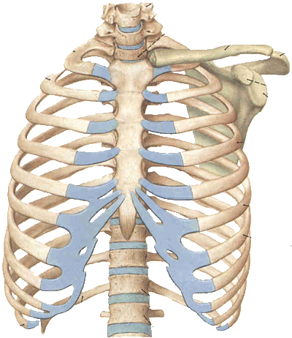
Synchondrosis
1. The Hyaline cartilage in these joint is temporary in nature & is replaced completely by bone.
e.g. Between Epiphysis & Diaphysis of a growing long bone
2. Immovable
4. It is a temporary form of joint

Slide 11
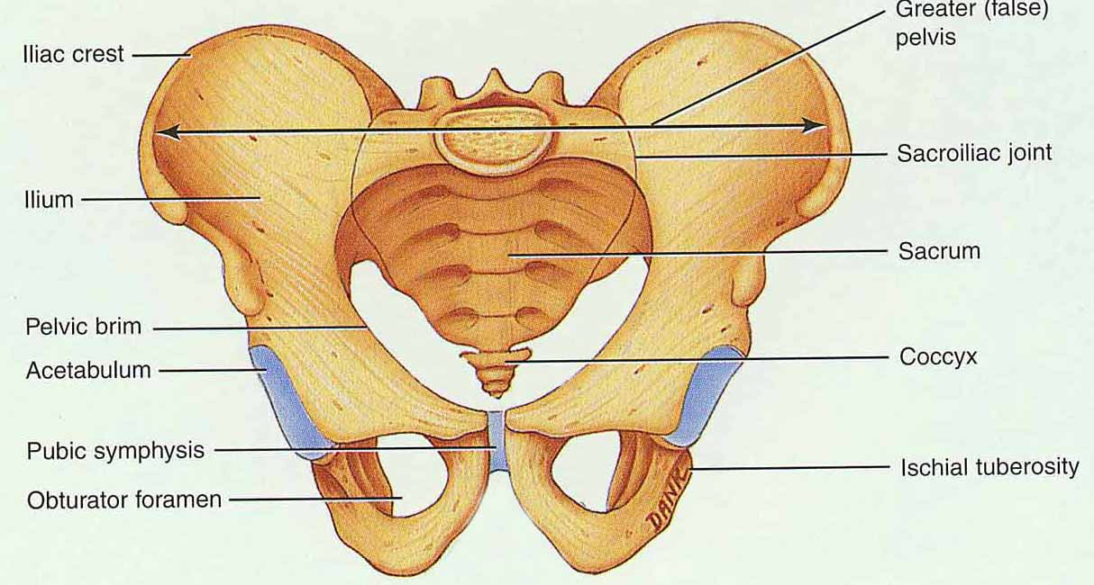
Symphysis
Fibrocartilage is connecting material
2. Slightly movable
3. Intervertebral discs and pubic symphysis

Slide 12
Difference between primary & secondary cartilaginous joint
Synchondroses | Symphysis
The articular cartilage is hyaline in nature | Hyaline cartilage but in between them there is a layer of fibro cartilage
Immovable | It allows little movement
Temporary | Usually permanent
The cartilage are ossified after a period of growth | Not so
Present in growing end of bone | All are present in the midline of the body
E.g. Joint between epiphyses & Diaphysis | E.g. Pubic symphysis, joint between the bodies of the vertebrae

Slide 13
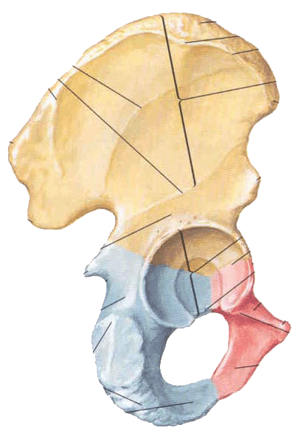
Synostosis
The bones are united by the ossification of the fibrous joint or synchondrosis between them, e. g. , the synosteosis between the ilium, ischium and pubis of the hip bones.

Slide 14
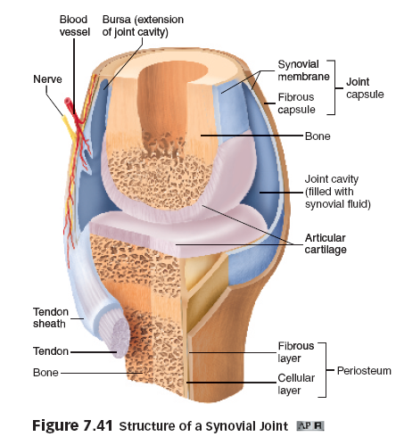
Diarthroses Synovial Joints
Synovial joints are freely movable joints that contain synovial fluid in a cavity surrounding the ends of articulating bones.

Slide 15
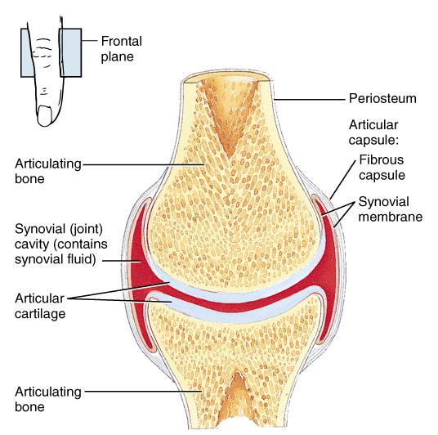
Essential structures of synovial joints
Articular surface: covered by articular cartilage
articular head
articular fossa
Articular capsule
Fibrous membrane
Synovial membrane
Articular cavity: containing a trace of synovial fluid; subatmospheric pressure in it

Slide 16
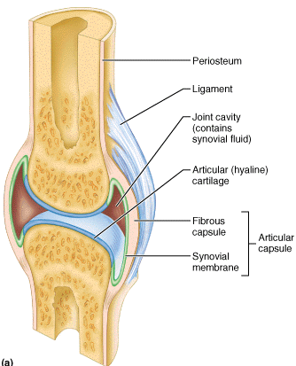
Characteristics
The participating bones are held together by an articular capsule
It is composed of an outer fibrous capsule & an inner synovial membrane
Synovial membrane lines the whole of the interior of the joint cavity except the articular surface
Articular surface are covered by articular cartilage

Slide 17
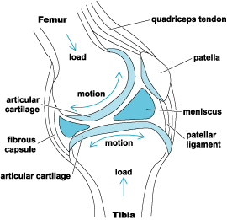
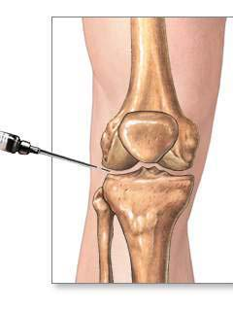
Characteristics
They are separated by narrow space called joint cavity
Cavity contains a colourless, transparent, viscous fluid, rich in hyaluronic acid called synovial fluid
Joint cavity may contain some intra articular structures like articular disc, meniscus etc.
Movement is permitted from limited to a wide range.

Slide 18
Synovial membrane
Synovial membrane
inner lining of capsule
secretes synovial fluid containing hyaluronic acid (slippery)
brings nutrients to articular cartilage

Slide 19
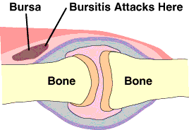
Synovial Bursa
It is a closed connective tissue sac lined with synovial membrane filled with synovial fluid.
Types
Subtendinous e.g. Biceps and subscapularis bursa
Articular e.g. subacromial bursa
Subcutaneous – e.g. pre patellar bursa
Functions
Diminishes friction
Allows free movement
Helps in lubrication

Slide 20
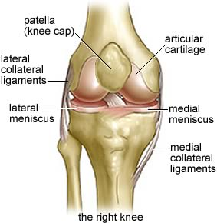
Intra articular Structures
Cartilaginous structure
Articular Disc
Articular Menisci
Glenoid Labrum
Ligaments traversing the joints
Ligamentum Teres of hip joint
Cruciate ligament of Knee joint
Muscle Tendon
Long head of Biceps- Shoulder Joint
Tendon of Popliteus- Knee Joint

Slide 21
Articular Disc / Articular Menisci
These are the fibro cartilaginous structures between articular surfaces dividing the joint cavity completely or incompletely
Articular Meniscus divides the joint incompletely into two compartments
Complete - e g. Sterno clavicular joint
Incomplete – e.g. Knee joint

Slide 22
Functions
Acts as a buffer & shock absorber
Strengthen the joint
Smooth in the articulation between the bony surfaces

Slide 23
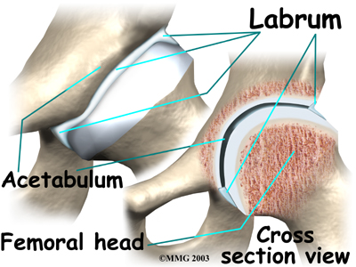
Articular Labra
It is a fibrocartilaginous annular lip which is attached to the margin of an articular surface
E.g. Glenoid cavity & acetabulum

Slide 24
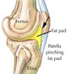
Articular fat pad
These are accumulation of adipose tissue present in many synovial joints
They are covered by synovial membrane E.g. Hip Joint
Makes the joint cavity uniform
Increase surface area of synovial joint

Slide 25
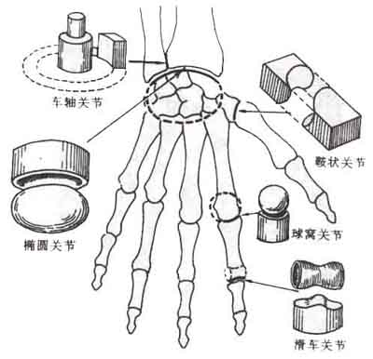
Types of synovial joints
Uniaxial joints:
hinge joints
trochoid (pivot) joints
Biaxial joints:
ellipsoid joints
saddle joints
Multiaxial joints:
ball-and-socket joint
plane joints

Slide 26
Uniaxial joints --Hinge Joint
Convex surface of one bones fits into concave surface of 2nd bone
Uniaxial like a door hinge
Examples
Knee, elbow, ankle, interphalangeal joints
Movements produced
flexion = decreasing the joint angle
extension = increasing the angle
hyperextension = opening the joint beyond the anatomical position

Slide 27
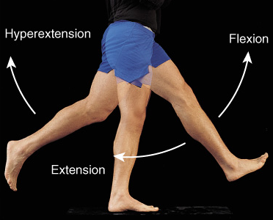
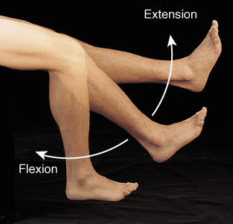
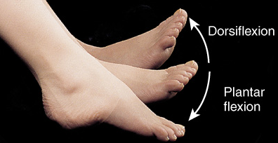
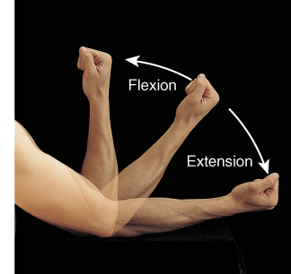
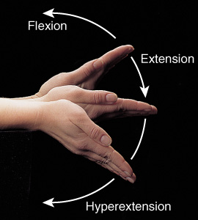
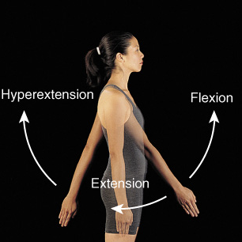
Flexion, Extension & Hyperextension

Slide 28
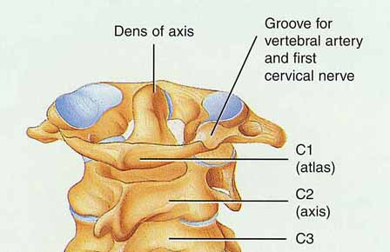
Uniaxial joints --Pivot Joint
Rounded surface of bone articulates with ring formed by 2nd bone & ligament
Monoaxial since it allows only rotation around longitudinal axis
Examples
Proximal radioulnar joint
supination
pronation
Atlanto-axial joint
turning head side to side “no”

Slide 29
Biaxial joints – Condyloid or Ellipsoidal Joint
Oval-shaped projection fits into oval depression
Biaxial = flex/extend or abduct/adduct is possible
Examples
wrist and metacarpophalangeal joints for digits 2 to 5

Slide 30
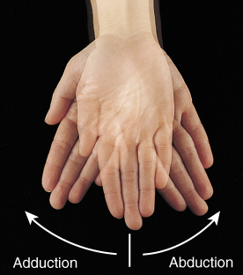
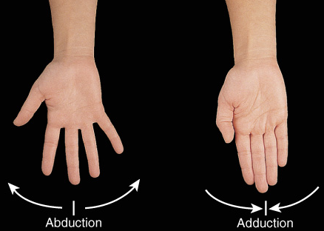
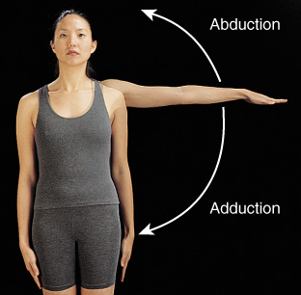
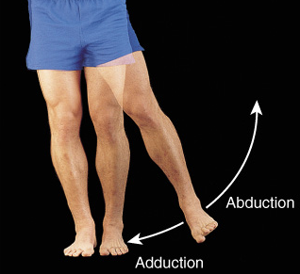
Adduction and Abduction
Condyloid joints
Ball and Socket joints

Slide 31
Biaxial joints – Saddle Joint
One bone saddled-shaped; other bone fits as a person would sitting in that saddle
Biaxial
Circumduction allows tip of thumb travel in circle
Opposition allows tip of thumb to touch tip of other fingers
Example
trapezium of carpus and metacarpal of the thumb

Slide 32
Multiaxial joints – Ball and Socket Joint
Ball fitting into a cuplike depression
Multiaxial
flexion/extension
abduction/adduction
rotation
circumduction
Examples
shoulder joint
hip joint

Slide 33
Multiaxial joints – Plane Joint
Bone surfaces are flat or slightly curved
Side to side movement only
Rotation prevented by ligaments
Examples
intercarpal or intertarsal joints
sternoclavicular joint
vertebrocostal joints

Slide 34
The joints of the bones of trunk

Slide 35
Ⅰ The vertebral column
1 The vertebral joints
nucleus pulposus annulus fibrosus
The intervertebral disc
The anterior longitudinal ligament
The posterior longitudinal ligament
The joints of the
vertebral bodies
Interspinal ligament
Supraspinal ligament
Intertransverse ligament
The joint of articular process
The joints of the
vertebral arches

Slide 36
2 The vertebral column as a whole and its movements
Anterior aspect
Dorsal aspect
Lateral aspect (4 curves)
The vertebral column as a whole
flexion and extension
rotation
circumduction
The movement of the vertebral column

Slide 37
Ⅱ The Thorax
The costovertebral joints
The costotransverse joints
1 Costovertebral joint
2 Sternocostal joints : true, false and floating rib
Superior
inferior
2 openings
3 walls
infrasternal angle
intercostal space
3 The thorax ( thoracic cage) as a whole

Slide 38
Articulations of Bones of Trunk
The vertebral column consists of 24 vertebrae, the sacrum, and the coccyx.

Slide 39
Joints of the vertebral bodies
Intervertebral discs
between bodies of adjacent vertebrae, composed of:
Nucleus pulposus, an inner soft, pulpy, highly elastic structure (gelatinous core )
Annulus fibrosus
an outer fibrous ring consisting of fibrocartilage

Slide 40
Hemination of nucleus pulposus

Slide 41
Anterior longitudinal ligament
Strong band covering the anterior part of the vertebral bodies and intervertebral discs running from the anterior margin of foramen magnum to the S1~S2
Maintains stability of the intervertebral disc and prevents hyperextension of the vertebral column
Posterior longitudinal ligament
Attached to the posterior aspect of the intervertebral discs and posterior edges of the vertebral bodies from C2 vertebra to sacrum
Prevents hyperflexion of the vertebral column and posterior protrusion of the discs

Slide 42
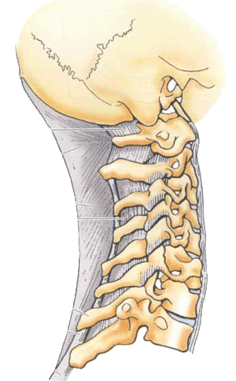
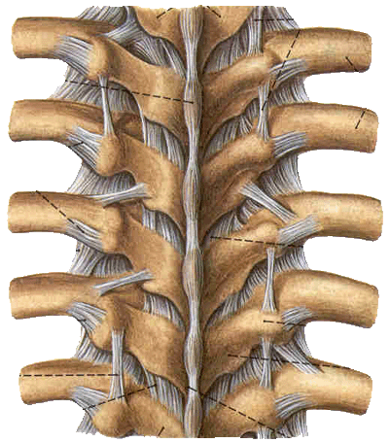
Joints of the vertebral arches
Ligamenta flava ― elastic ligament, unite laminae of adjacent vertebrae, and complete the posterior wall of vertebral canal; tend to prevent hyperflexion of the vertebral column
Interspinal ligament
Supraspinal ligament
Intertansverse ligament

Slide 43
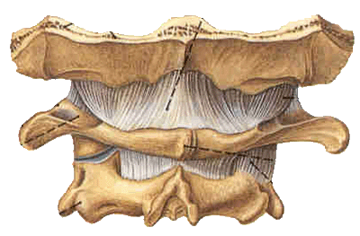
Atlantooccipital joint
Between superior articulating surfaces of atlas and occipital condyles
Supported by membrances and ligaments that join occipital bone and atlas
Action ― nodding of head, lateral tilting of head

Slide 44
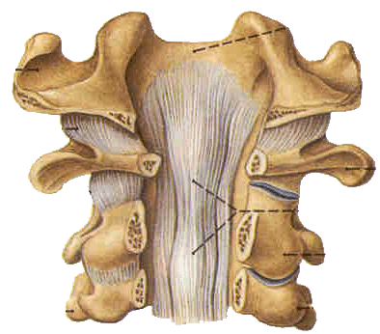
Atlantoaxial joint
Three synovial joints between atlas and axis
Laterally, paired joints between articulating facets
Median joint between dens of axis and anterior arch of atlas
Supported by ligaments
apical ligament of dens
alar ligament
transverse ligament of atlas
tectorial membrane
Action ― allow atlas (and head) to pivot on the axis and vertebral column

Slide 45
Normal Curves of vertebral column
Cervical curvature convex forward
Thoracic curvature convex backward
Lumbar curvature
convex forward
Sacral curvature convex backward
Movement of the vertebral column
flexion
extension
lateral flexion
rotation

Slide 46
Thoracic cage
Composition
Bones ― consists of twelve thoracic vertebrae, twelve pairs of ribs and costal cartilages, and sternum

Slide 47
Joints
Costovertebral joints
Joints of costal head
Costotransverse joints
Sternocostal joints
Sternocostal synchondrosis of first rib
Sternocostal joints
Interchondral joints: between costal cartilages 8, 9, and 10 to form the costal arch

Slide 48
General features of thoracic cage
Roughly cone-shape, narrow above and broad below, flattened from before-backwards, longer behind than in front
Inlet of thorax: bounded by upper border of manubrium, first rib, and vertebra T1
Outlet of thorax: bounded by vertebra T12, 12th and 11th ribs, costal arch and xiphoid process
Infrasternal angle: formed by the costal arch of both side
Intercostal spaces: lie between the ribs

Slide 49
Function:
protects the organs in the thoracic cavity and upper abdominal cavity;
plays a vital role in the process of breathing
Inspiration
Expiration

Slide 50
Joints of skull
Continuous joints: sutures, synchondrosis or synosteosis

Slide 51
Temporomandibular joint
Aticulating surfaces
Mandibular fossa and articular tubercle, above
Head of mandibule, below
Capsule: thin and lax in front and behind; strengthened by the lateral ligament
Articular disc: separates surfaces, forming upper and lower compartments within joint
Movement: mandible may be elevated or depressed, protruded or retracted; rotation may also occurs as in chewing( a slight amount of side to side movement is also permitted)

Slide 52
THANK
YOU
VERY
MUCH

