Slide 1
Glands
Dr.Pardeep Kumar

Slide 2
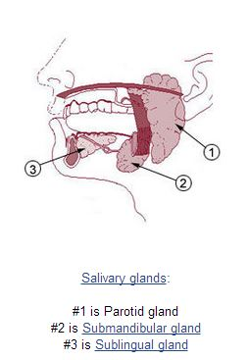
Glands
Glands are group of cells whose function is secretion.
Classification
According to nature of secretion
Mucous – viscous, slimy secretion
Unicellular – e.g. goblet cells
Multicellular – e.g. palatine glands
Serous - secretion is watery e.g. Parotid gland, Pancreas.
Mixed Contain both mucous & serous
secreting cells & secretion is of both types
e.g. Sub mandibular gland, Sublingual gland

Slide 3
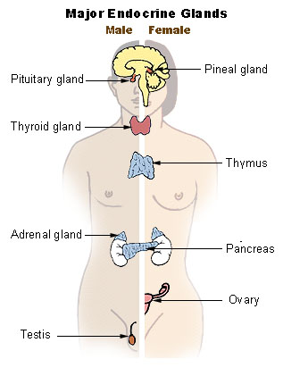
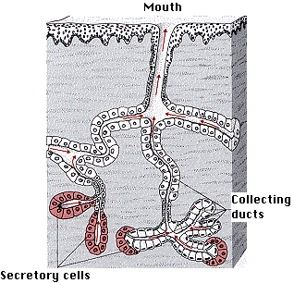
According To the method of secretion transport
Exocrine – Discharge their secretion by means of duct in epithelial surface e.g. Parotid gland
Endocrine : Release their secretion directly into blood or lymph vessels e.g. Pituitary

Slide 4
Both glands are developmentally derived from epithelia, which form a down-growth into the underlying connective tissue.
The cells then develop the special characteristics of the mature gland.
Exocrine glands maintain the connection with the surface epithelium, whereas the connection is lost by endocrine glands.

Slide 5
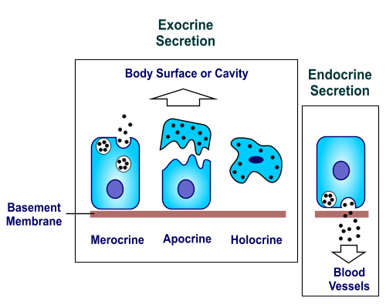
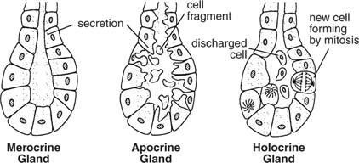
According to mode of secretion
Holocrine :secretions are produced within the cell followed by the rupture of the plasma membrane, thus releasing the cellular contents into the lumen.
e.g. Sebaceous glands
Apocrine: producing a fluid secretion by pinching off one end of the secreting cells which then reform and repeat the process e.g Mammary glands, apocrine sweat glands .
Merocrine: Only the secretory material is discharged e.g. endocrine glands, digestive glands.

Slide 6
According to Development
Ectodrerm – e.g. Parotid gland, Lacrimal gland
Endoderm e.g. Thymus, Liver, Pancreas, thyroid
Mesoderm e.g. Kidney, Spleen.

Slide 7
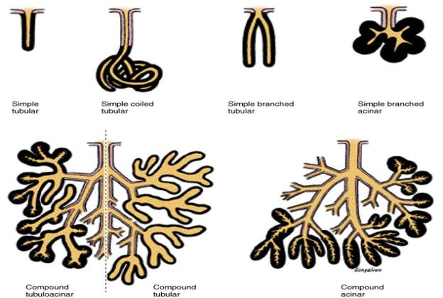
According to Structure

